Slide 1
SVM Case Study

Slide 2

Telcorp example
SVM Case

Slide 3
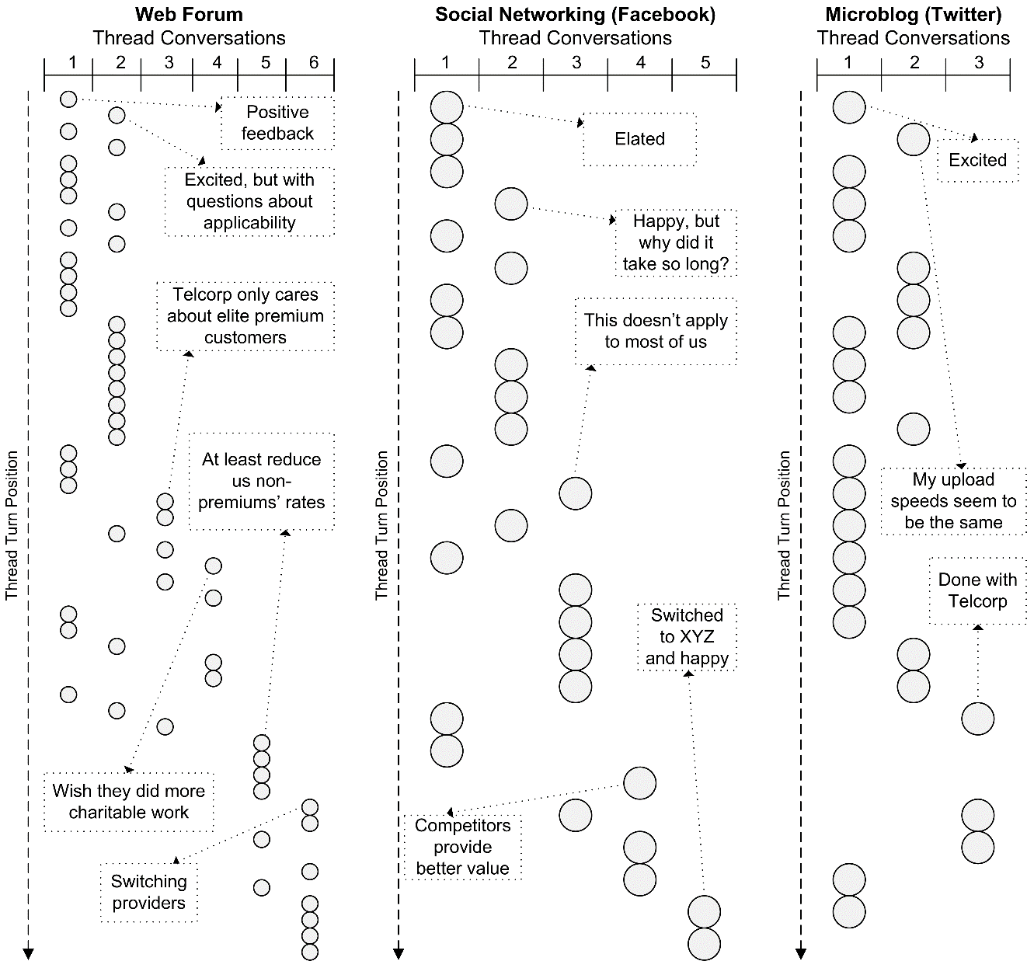
Issues at Telcorp
SVM Example
Conversation Disentanglement

Slide 4
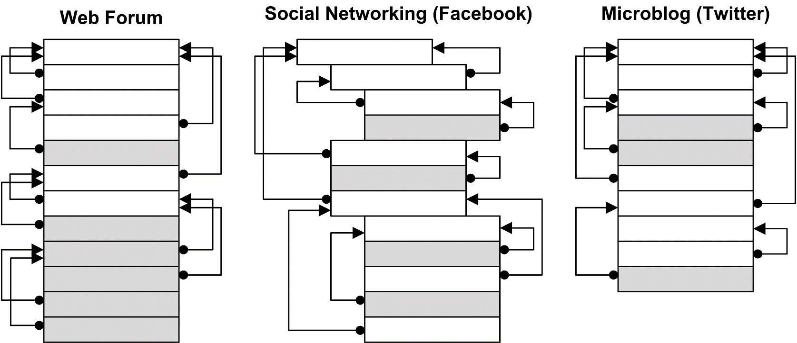
Issues at Telcorp
SVM Example
Coherence Analysis

Slide 5
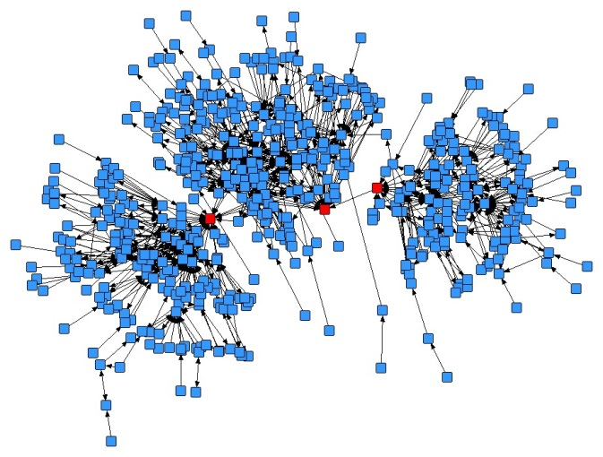
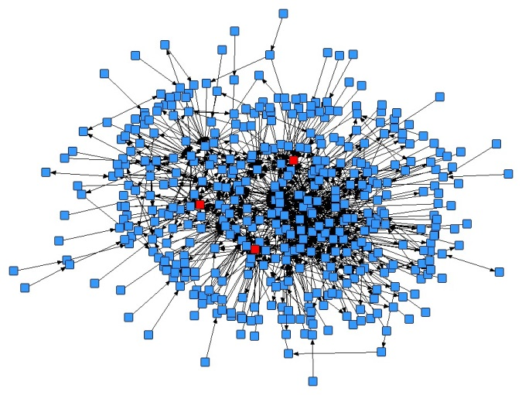
Issues at Telcorp
SVM Example
Coherence Analysis Implications
Web Forums
Twitter
Facebook
Actual Network
Constructed Network

Slide 6
Issues at Telcorp
SVM Example
Speech Act Analysis

